Slide 1
IN-SYNC aDAPTIVE Traffic control system

Slide 2
GROUP Members
Muneeb Ishaq
Asim Noor
Abdul Basit

Slide 3
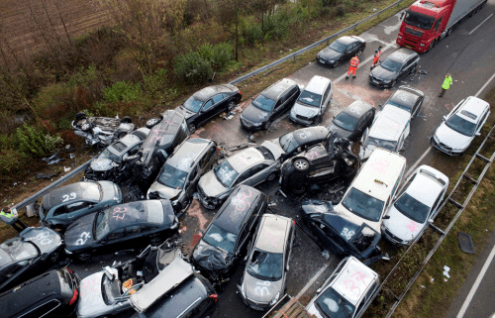
REASONS BEHIND THE PROJECT

Slide 4
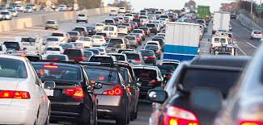
Another Reason

Slide 5
SOFTWARES AND THINGS USED
Arduino UNO
Photo resistor
IR tracker sensor
RGB LED
Simple LEDS
Button

Slide 6
MORE ABOUT IMPROVEMENTS
Traffic Signal improvement
STREET LIGHTS
Pedestrian light

Slide 7
VIDEO:
The video is too big too be uploaded on lms although we had showed you on our presentation.

Slide 8
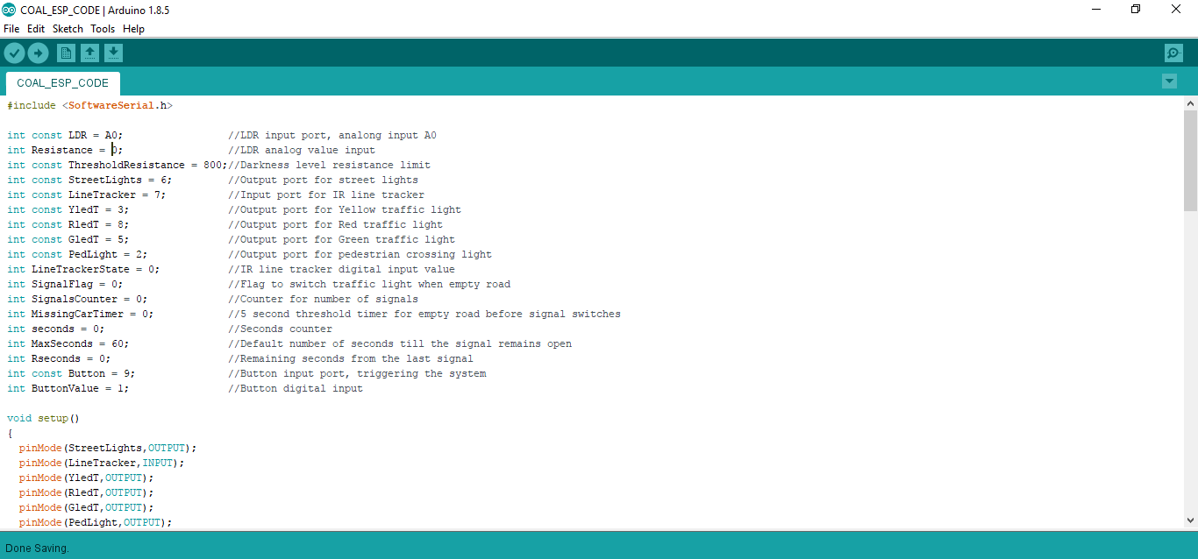
ARDUINO CODE:

Slide 9
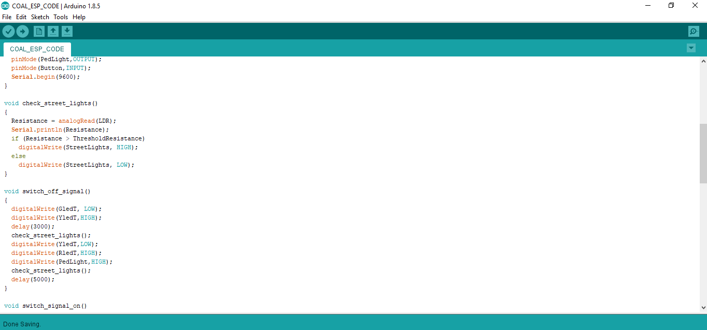
ARDUINO CODE:

Slide 10
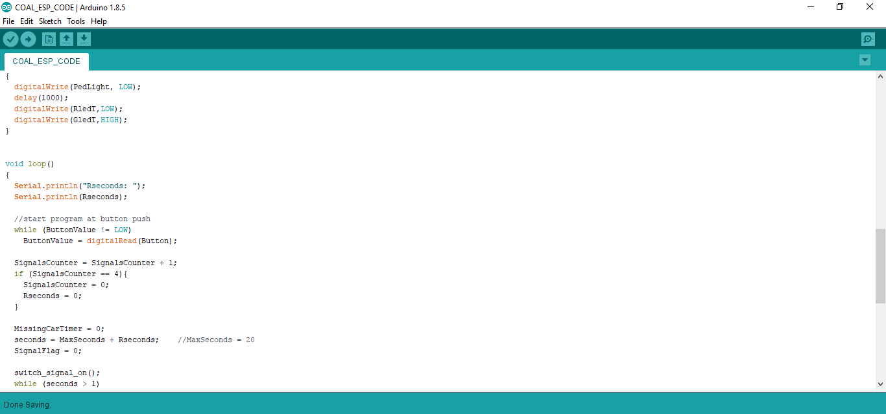

ARDUINO CODE:

Slide 11
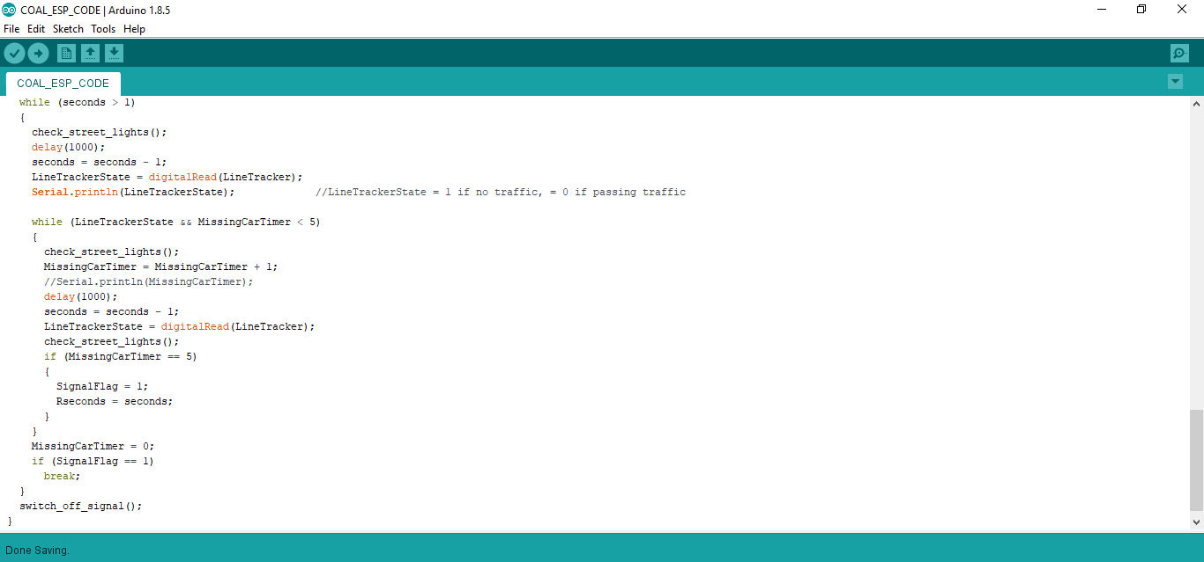
ARDUINO CODE:

Slide 12
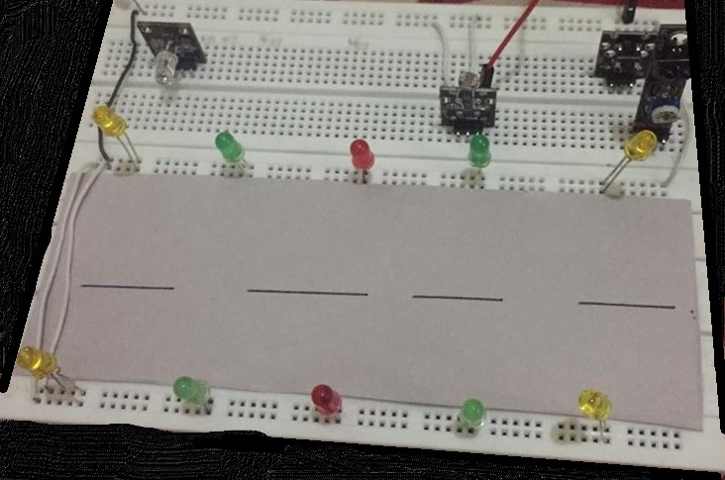
TIME FOR DEMO

Slide 13

Any questions ??
Feel free to ask

Slide 14


